Slide 1
Design and Analysis of Algorithms
Recursion Tree
National University of Computer and Emerging Sciences, Islamabad

Slide 2
Methods to solve recurrence
Iteration method
Recursion tree method
Master Theorem

Slide 3
Divide and Conquer
The divide-and-conquer paradigm
What is a paradigm? One that serves as a pattern or model.
Divide the problem into a number of subproblems
Conquer the subproblems by solving them recursively. If small enough, just solve directly without recursion
Combine the solutions of the subproblems into the solution for the original problem

Slide 4
Analyzing Divide-and-Conquer Algorithms
Let T(n) be the running time on a problem of size n.
If problem is small enough, then solution takes constant time (this is a boundary condition, which will be assumed for all analyses)
It takes time to divide the problem into sub-problems at the beginning. Denote this work by D(n).

Slide 5
Analyzing Divide-and-Conquer Algorithms
It takes time to combine the solutions at the end. Denote this by C(n).
If we divide the problem into ‘a’ problems, each of which is ‘1/b’ times the original size (n), and since the time to solve a problem with input size ‘n/b’ is T(n/b), and this is done ‘a’ times, the total time is:
T(n) = Θ(1), n small (or n ≤ c )
T(n) = aT(n/b) + D(n) + C(n)

Slide 6
Example
Function(int number)
if number<=1
then return;
else
Function(number/2)
Function(number/2)
for(i=1 to number )
Display i;
It follows that
T(n) = 2 T(n/2)+ cn
work done dividing and combining
number of sub-problems
Sub-problem size

Slide 7
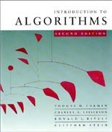
Recursion tree
Solve T(n) = 2T(n/2) + cn, where c > 0 is constant.

Slide 8
Recursion tree
Solve T(n) = 2T(n/2) + cn, where c > 0 is constant.
T(n)

Slide 9
Recursion tree
Solve T(n) = 2T(n/2) + cn, where c > 0 is constant.
cn
T(n/2)
T(n/2)

Slide 10
Recursion tree
Solve T(n) = 2T(n/2) + cn, where c > 0 is constant.
cn
cn/2
cn/2
T(n/4)
T(n/4)
T(n/4)
T(n/4)

Slide 11
Recursion tree
Solve T(n) = 2T(n/2) + cn, where c > 0 is constant.
cn
cn/2
cn/2
cn/4
cn/4
cn/4
cn/4
Θ(1)

Slide 12
Recursion tree
Solve T(n) = 2T(n/2) + cn, where c > 0 is constant.
cn
cn/2
cn/2
h = lg n
cn/4
cn/4
cn/4
cn/4
Θ(1)

Slide 13
Recursion tree
Solve T(n) = 2T(n/2) + cn, where c > 0 is constant.
cn cn
cn/2
cn/2
h = lg n
cn/4
cn/4
cn/4
cn/4
Θ(1)

Slide 14
Recursion tree
Solve T(n) = 2T(n/2) + cn, where c > 0 is constant.
cn cn
cn/2 cn
cn/2
h = lg n
cn/4
cn/4
cn/4 cn/4
Θ(1)

Slide 15
Recursion tree
Solve T(n) = 2T(n/2) + cn, where c > 0 is constant.
cn cn
cn/2 cn
cn/2
h = lg n
cn/4
cn/4
cn/4 cn/4 cn
…
Θ(1)

Slide 16

Recursion tree
n=8
Solve T(n) = 2T(n/2) + cn, where c > 0 is constant.
8c cn
4c cn
4c
h = lg n
2c
2c
2c 2c cn
…
Θ(1)
#leaves = n
Θ(n)

Slide 17
Recursion tree
Solve T(n) = 2T(n/2) + cn, where c > 0 is constant.
cn cn
cn/2 cn
cn/2
h = lg n
cn/4
cn/4
cn/4 cn/4 cn
…
Τ(n/2^{K})
T(n/2^{K})

Slide 18
Number of Iterations
Τ(n/2^{K})
n/2^{K} =1
n=2^{K}
log (n )= log (2^{K} )
log (n)= k log 2
log (n) / log 2= k
k = log (n) / log 2
k = lg n
Note: Number of iterations = lg n

Slide 19
Recursion tree
Solve T(n) = 2T(n/2) + cn, where c > 0 is constant.
cn cn
cn/2 cn
cn/2
h = lg n
cn/4
cn/4
cn/4 cn/4 cn
…
Θ(1)
#leaves = n
Θ(n)

Slide 20
Recursion tree
Solve T(n) = 2T(n/2) + cn, where c > 0 is constant.
cn cn
cn/2 cn
cn/2
h = lg n
cn/4
cn/4
cn/4 cn/4 cn
…
Θ(1)
#leaves = n
Θ(n)
Total = Θ(n lg n)

Slide 21
Recursion Tree for Algorithm
cn
T(n/2)
T(n/2)

Slide 22
Recursion Tree for Algorithm
cn
cn/2
cn/2
T(n/4)
T(n/4)
T(n/4)
T(n/4)

Slide 23
Recursion Tree for Algorithm
cn
cn/2
cn/2
T(n/4)
T(n/4)
T(n/4)
T(n/4)
Eventually, the input size (the argument of T) goes to 1, so...

Slide 24
Recursion Tree for Algorithm
cn
cn/2
cn/2
T(n/4)
T(n/4)
T(n/4)
T(n/4)
T(1)
T(1)
T(1)
T(1)
.............................
T(1)
T(1)
n sub problems of size 1, but T(1) = c by boundary condition

Slide 25
Recursion Tree for Algorithm
cn
cn/2
cn/2
T(n/4)
T(n/4)
T(n/4)
T(n/4)
c
c
c
c
.............................
c
c
n subproblems of size 1

Slide 26
Recursion Tree for Algorithm
level nodes/ cost/
level level
0 2⁰ = 1 cn
1 2¹ = 2 cn
2 2² = 4 cn
. .
. .
. .
K 2^{k}=n cn
Since 2^{k} = n,
K= lg(n)
levels = k = lg(n)
T(n) = total cost = (levels)(cost/level)
T(n) = cn [1+lg(n)] = O( n lg(n))
n nodes at level N-1

Slide 27
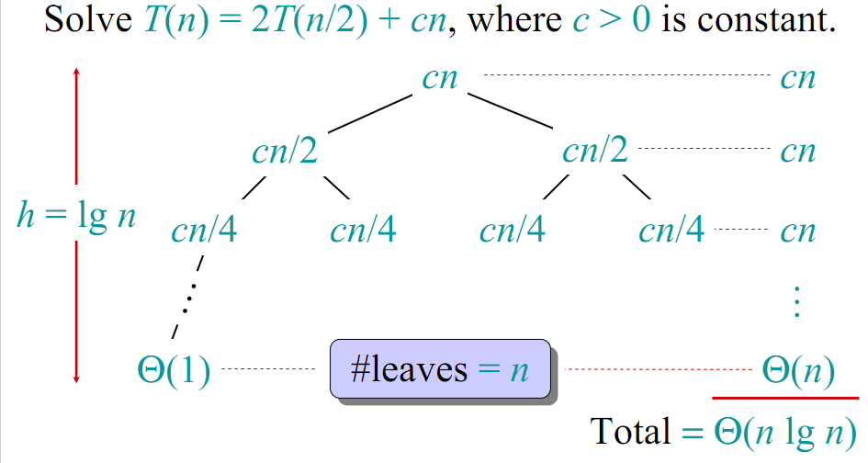
Visual Representation of the Recurrence for Merge Sort

Slide 28
Conclusions
Θ(nlgn) grows more slowly than Θ(n²)
Therefore, merge sort asymptotically beats insertion sort in the worst case.
In practice, merge sort beats insertion sort for n > 30 or so.
Go test it out for yourself!

Slide 29
Sorting algorithms
Selection and bubble sort have quadratic best/average/worst-case performance
Insertion sort has quadratic average-case and worst-case performance
The faster comparison based algorithm ?
O(nlogn)
Mergesort and Quicksort

Slide 30
Recursion Tree

Slide 31
Recursion Tree
cost
cn²
cn²
T(n/4 )
T(n/4 )
T(n/4 )

Slide 32
Recursion Tree
cost
cn²
cn²
3/16cn²

Slide 33
Recursion Tree
cost
cn²
cn²
3/16cn²
(3/16)²cn²
What is the cost at each level?

Slide 34
Depth of Tree?
At each level, the size of the data is divided by 4
d shows level number
If n=64 then depth would be 3, [which is 4 raise to power 3]
Formula for:
log base 4 is
log 64/log 4 =3
Notes:
If n=64 then depth would be 3, [which is 4 raise to power 3]

Slide 35
How many Leaves?
cn²

Slide 36
How many Leaves?
How many leaves are there in a complete tree of depth d?
If n=64
d=3
The leaves would be
27=3³
Notes:
If n=64
D=3
The leaves would be
27=3³

Slide 37
Total Cost
let x = 3/16
?

Slide 38
Total Cost
?
Take Home Task:
Check it for large values of n,
Draw graph for both of the above functions for large values of n and determine the dominating term

Slide 39
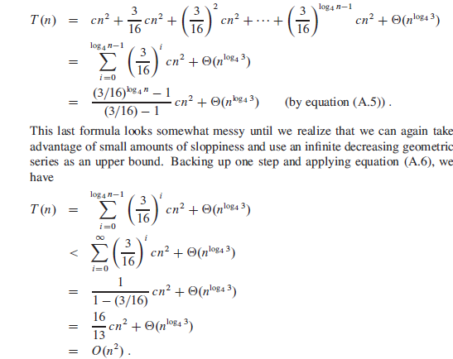
Total Cost

Slide 40
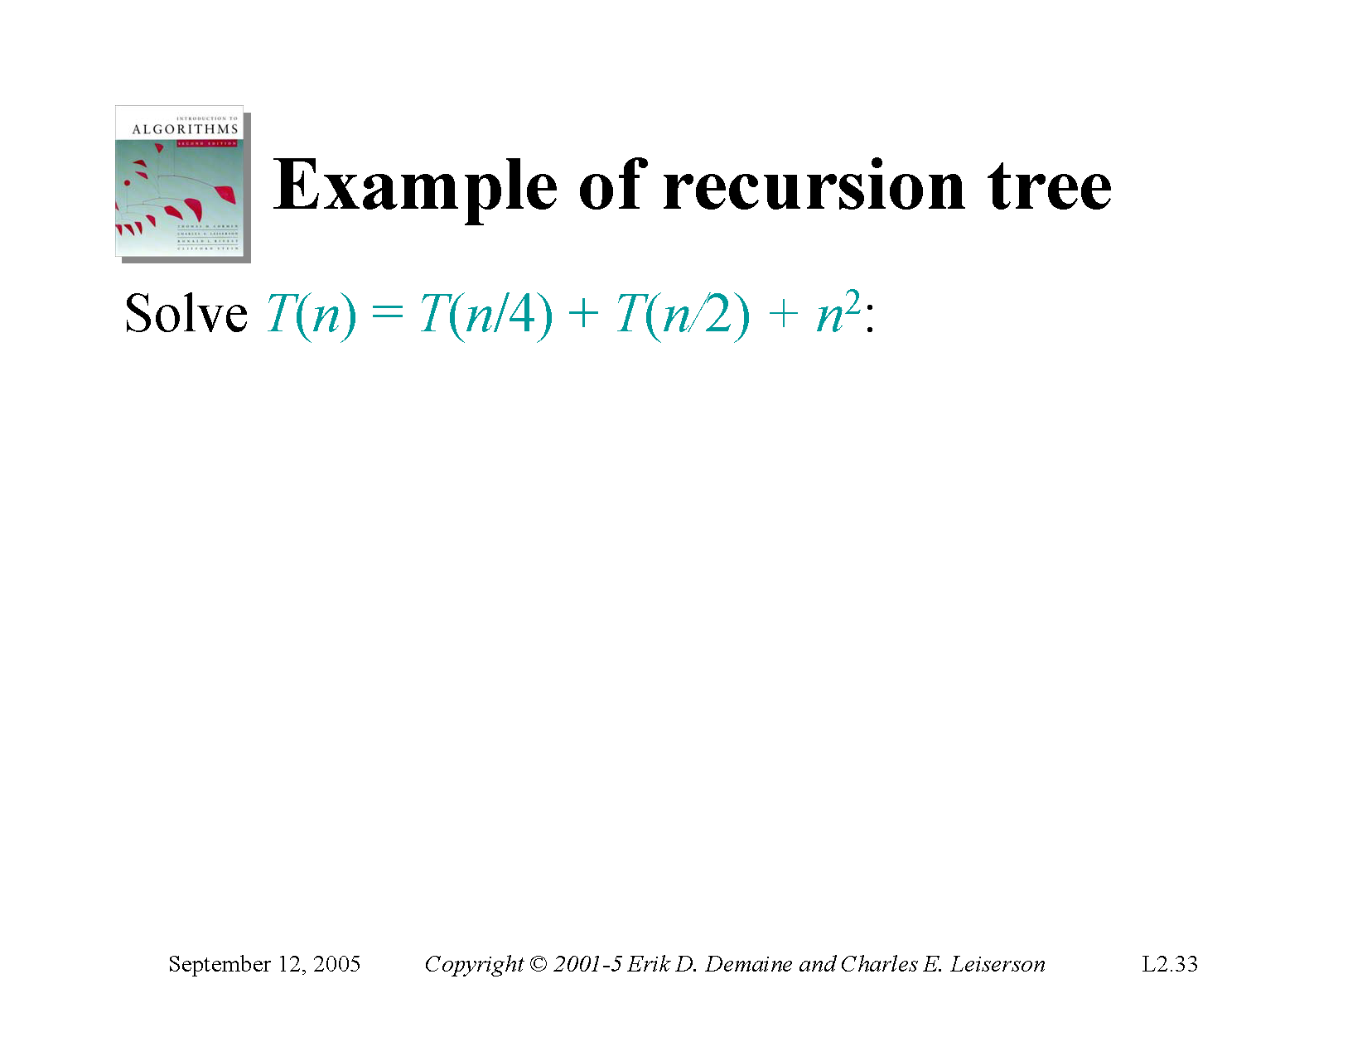

Slide 41
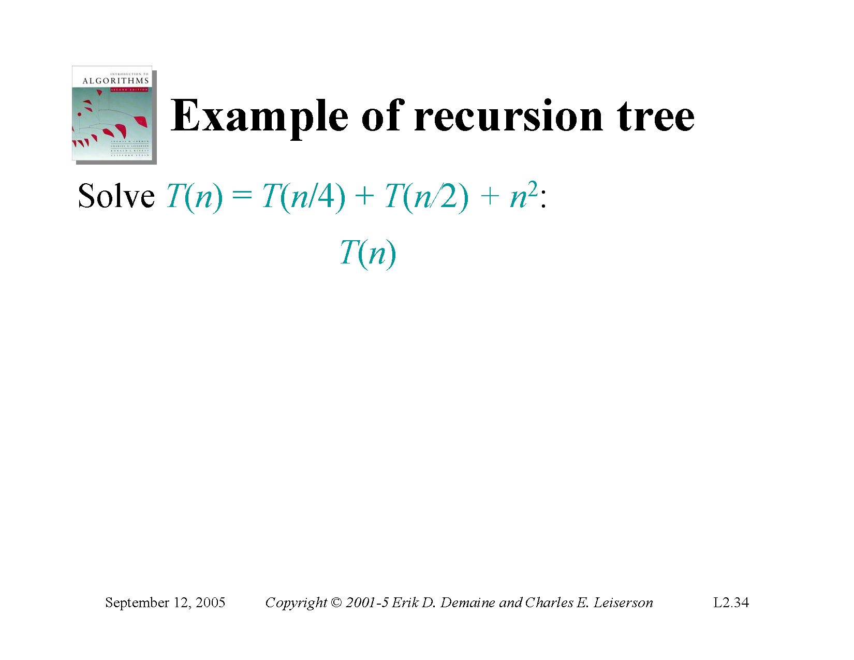

Slide 42
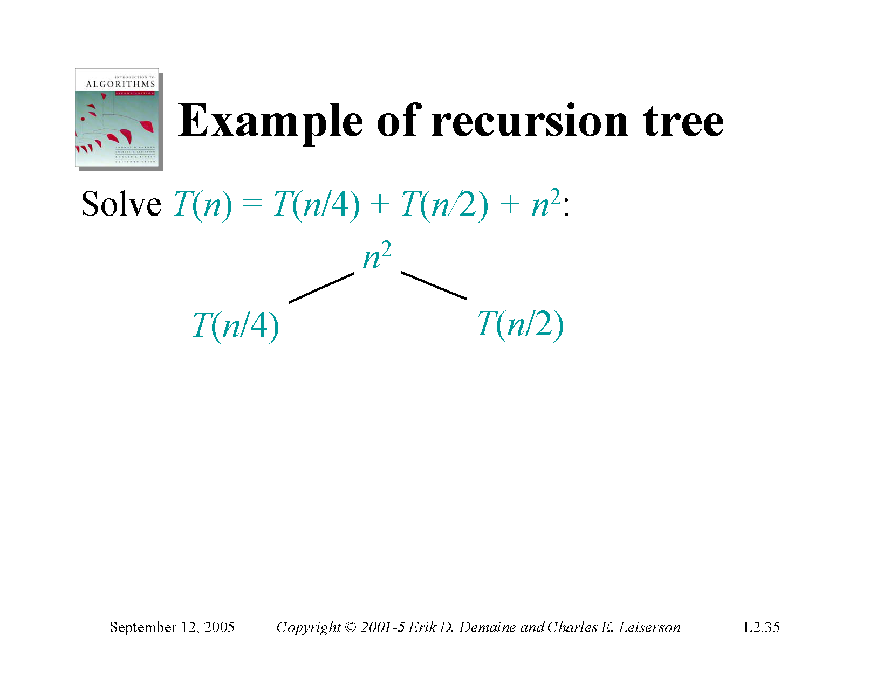

Slide 43
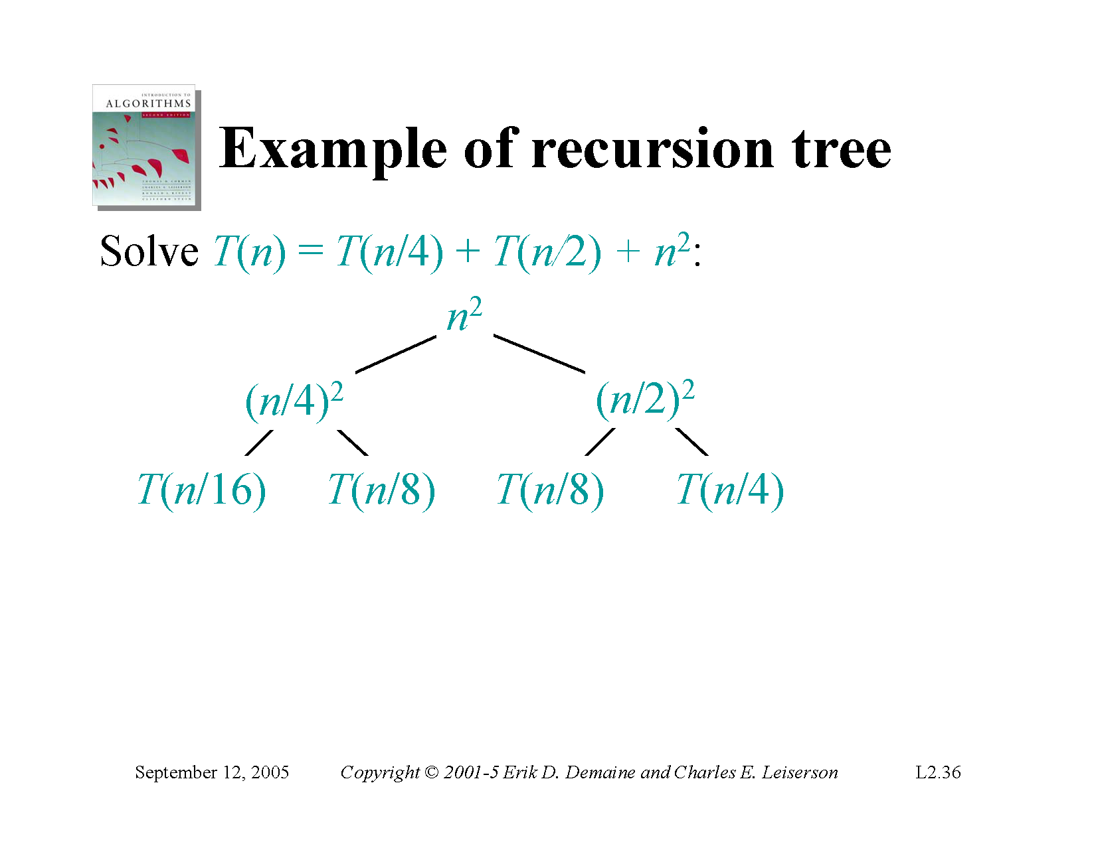

Slide 44
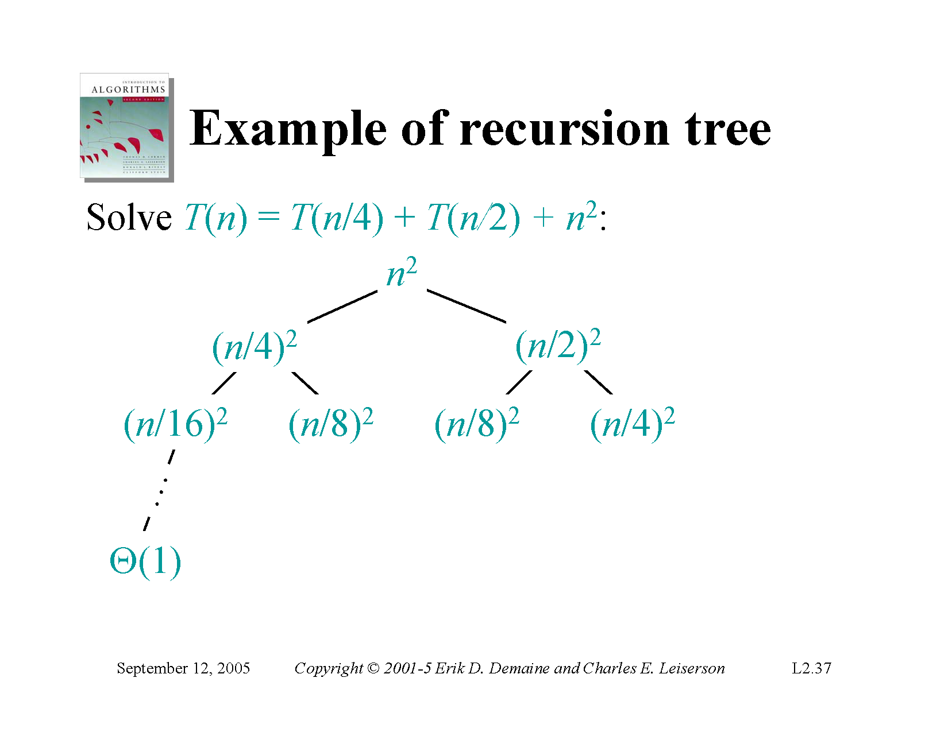

Slide 45


Slide 46
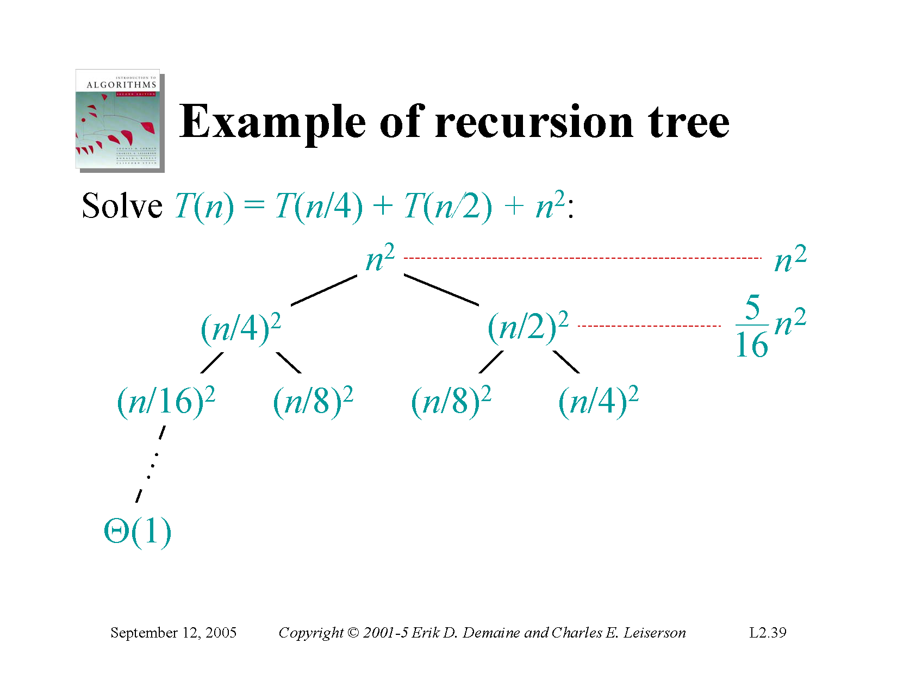

Slide 47
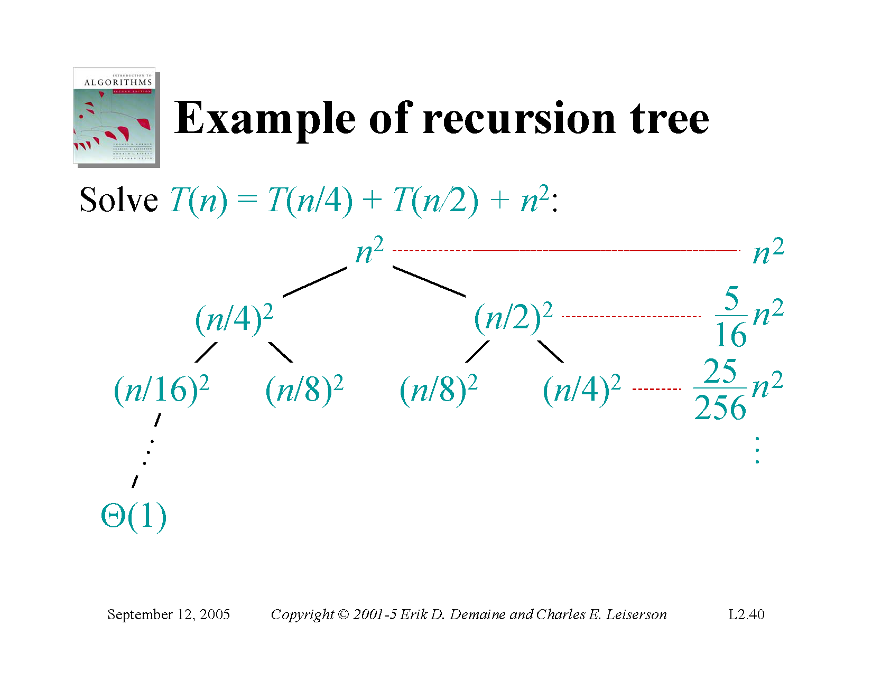

Slide 48
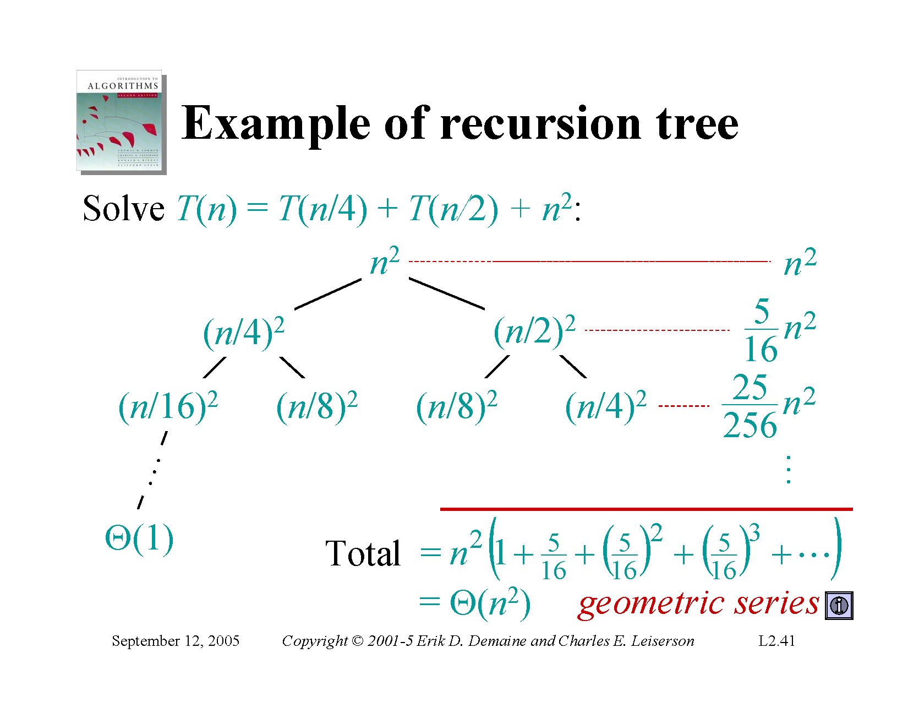

Slide 49
Practice
Show that
T(n) = 2T(n/2) + n² is O(n²) by recursion tree and iteration method
Show that T(n) = T(n/3) + T(2n/3) + n is O(n log n) by recursion tree method
Solution link:
https://www.cs.cornell.edu/courses/cs3110/2012sp/lectures/lec20-master/lec20.html

Slide 50
Reference
Introduction to Algorithms
4.1, 4.3, 4.4
Chapter # 4
Thomas H. Cormen
3rd Edition

